Slide 1
SAMPLE SLIDE
1
1

Slide 2
SAMPLE SLIDE 1
I use PowerPoint to my advantage
Projecting the best image
Can you hear me?
Can you see my slides?
Are my slides also visible from the back of the room?
AV-friendly meeting space
2

Slide 3
SAMPLE SLIDE 2
Speaking at ibaeconf
What to think about?
Keep it simple
Larger text is easier to read
Single words rather than sentences
Bullet points are there to remind you, not to tell the whole story
3
3

Slide 4
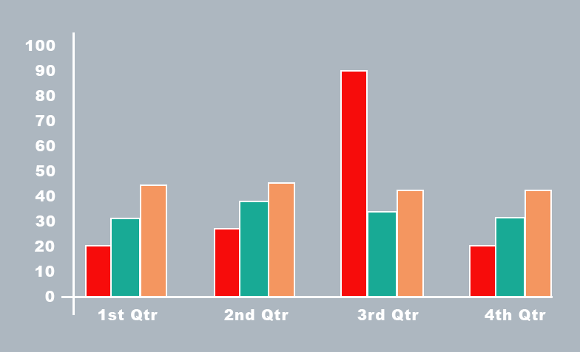
SAMPLE SLIDE 3
4
4

